Slide 1
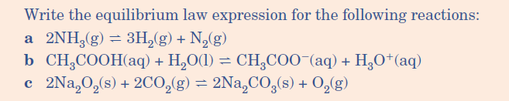


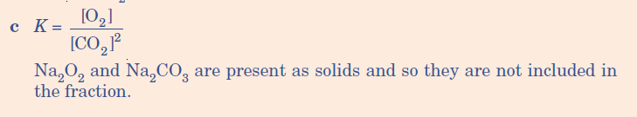
Quick Quiz
Remember (l) and (s) are not included in the equations only (aq) and (g) !

Slide 2
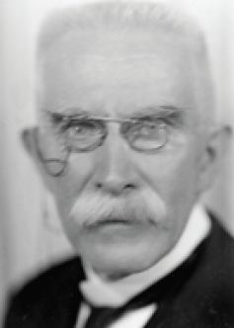

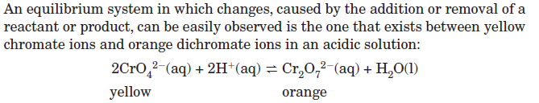
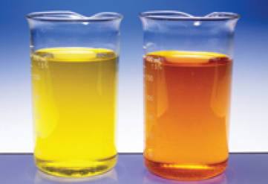

Henri Louis Le Châtelier (1850 –1936) was an influential French chemist of the late 19th and early 20th centuries. He is most famous for devising Le Châtelier's principle, used by chemists to predict the effect a changing condition has on a system in chemical equilibrium

Slide 3
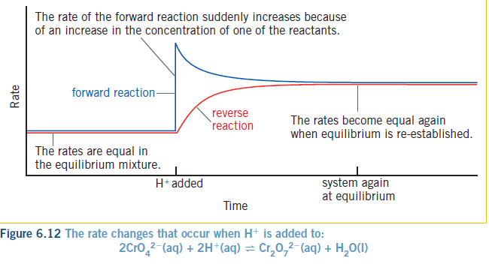

Slide 4
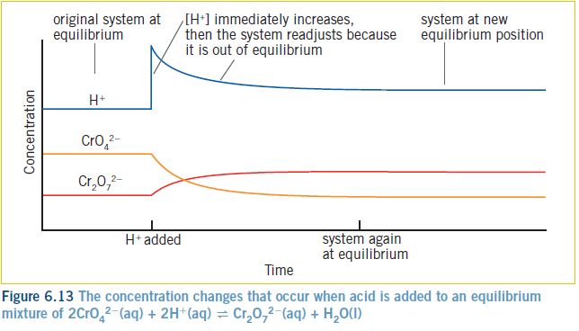

Slide 5




Slide 6
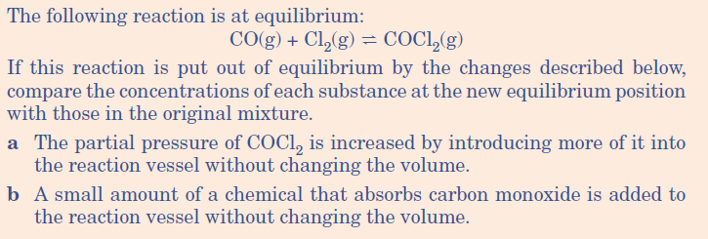
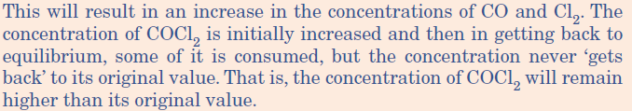

Slide 7


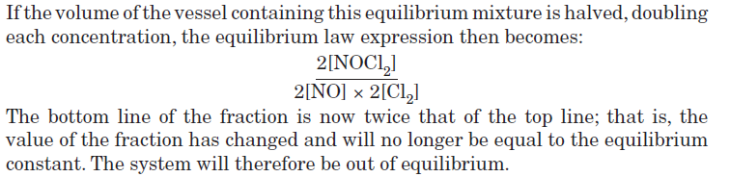
Equilibrium will re-adjust to decrease the pressure and move to the side that produces
Less volume so move to the product side and NOCl₂ concentration will increase

Slide 8
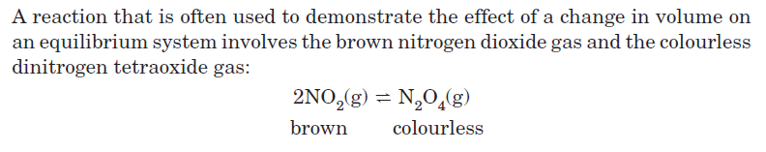
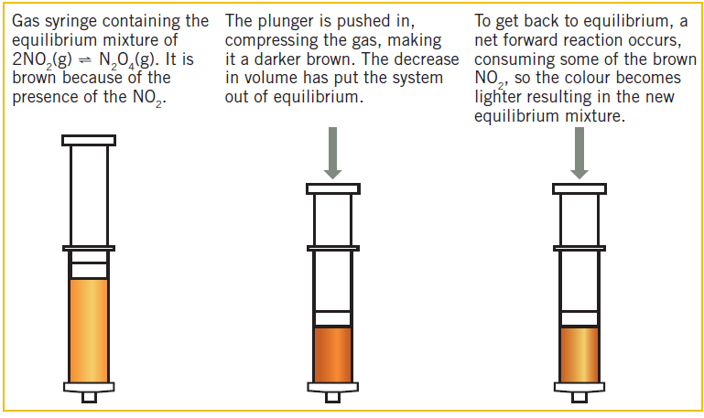

Slide 9
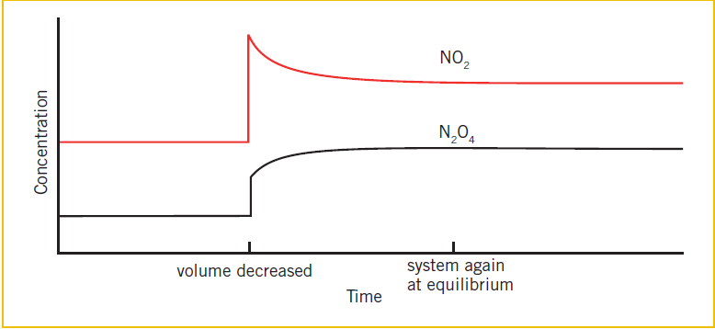

Slide 10


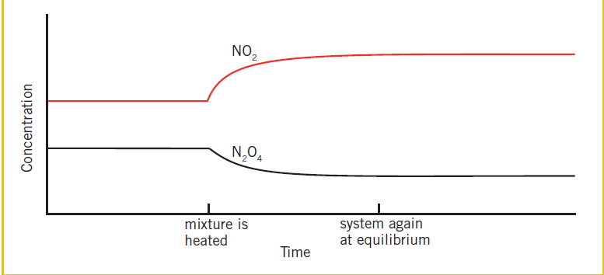

Slide 11
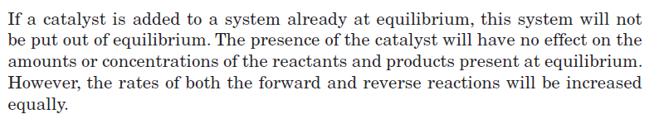

Slide 13
Haber process
Manufacture of ammonia NH₃ for the fertilizer industry
N₂
3 H₂
2 NH₃
H= - 92.4kJ
+
2
NH₃
Kc =
N₂
H₂
3
x

Slide 14
Haber process
Manufacture of ammonia NH₃ for the fertilizer industry
N₂
3 H₂
2 NH₃
H= - 92.4 kJ
+
Le Chatelier’s principle predicts the yield of NH₃ is maximised by
Low temperature
High pressure
Actual temp used is 500ºC (as lower temp reduces the rate )
Pressure used is 200 ATM

Slide 15

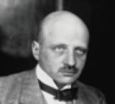

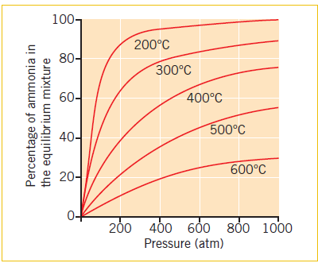
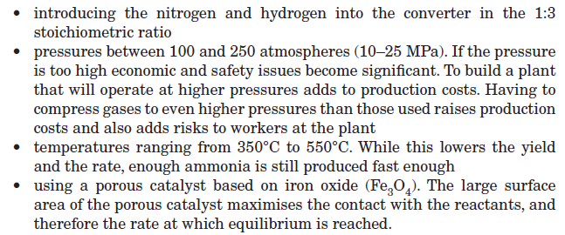

Slide 16
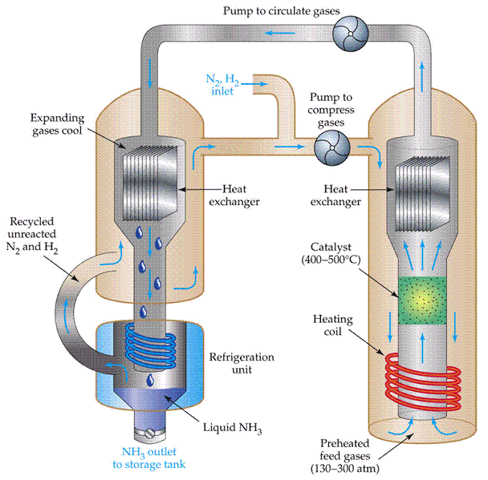

Slide 17
Contact process
Part of the Manufacture of Sulfuric acid H₂SO₄
2SO₂
O₂
2 SO₃
H= - 198kJ
+
Le Chatelier’s principle predicts the yield of SO₃ is maximised by
Low temperature
High pressure
Actual temp used is 450 ºC (as low temp reduces the rate )
Pressure used is 1 ATM

Slide 19
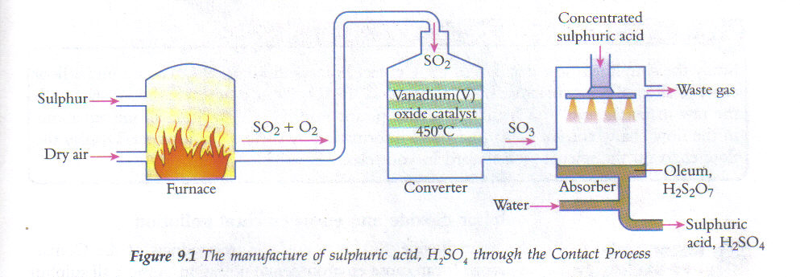

Slide 20
You are to produce a one page summary sheet on the Contact Process.
Points to address/research:
4 equations one is a reversible reaction what can you change to favour the forward reaction.
Macroscopic properties, temp, pressure, catalysts.
What is produced?
Exo or endothermic process?
Uses of H₂SO₄?
Lucarelli page 165-167

